Slide 1
How Much sugar is in that?
Do you know….

Slide 2
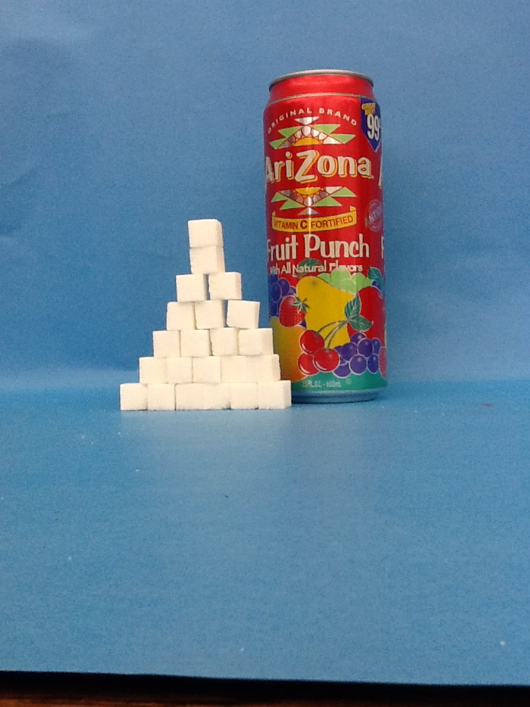
Arizona Fruit Punch
Serving Size: 8 fl. Oz.
Calories: 100
Carbohydrates: 26g
Sugar: 25g

Slide 3
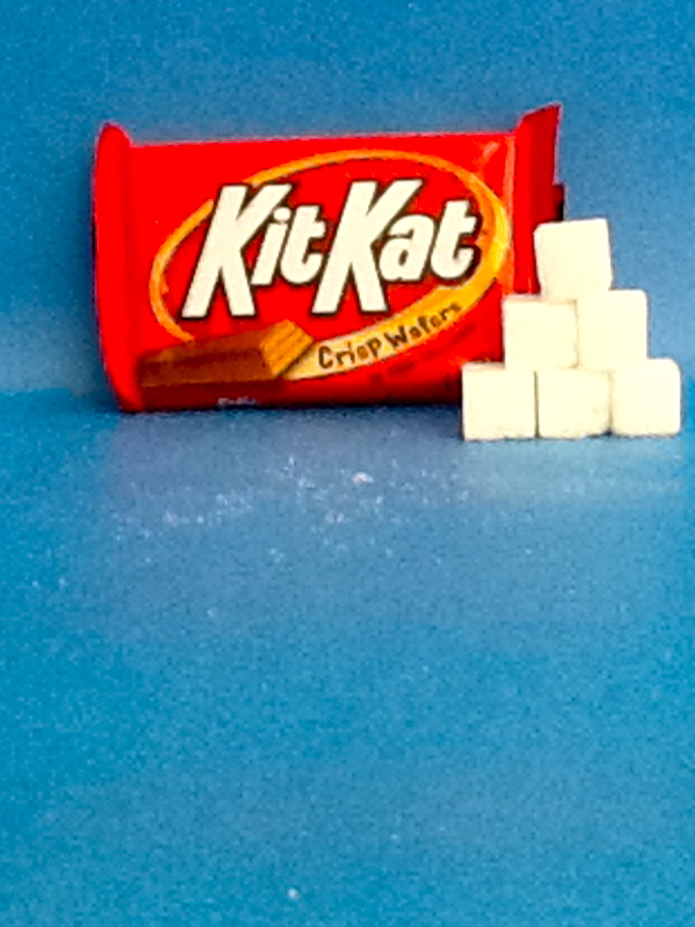
Kit Kat
Serving Size: 1 Bar
Calories: 218
Carbohydrates: 17 g
Sugar: 20 g

Slide 4
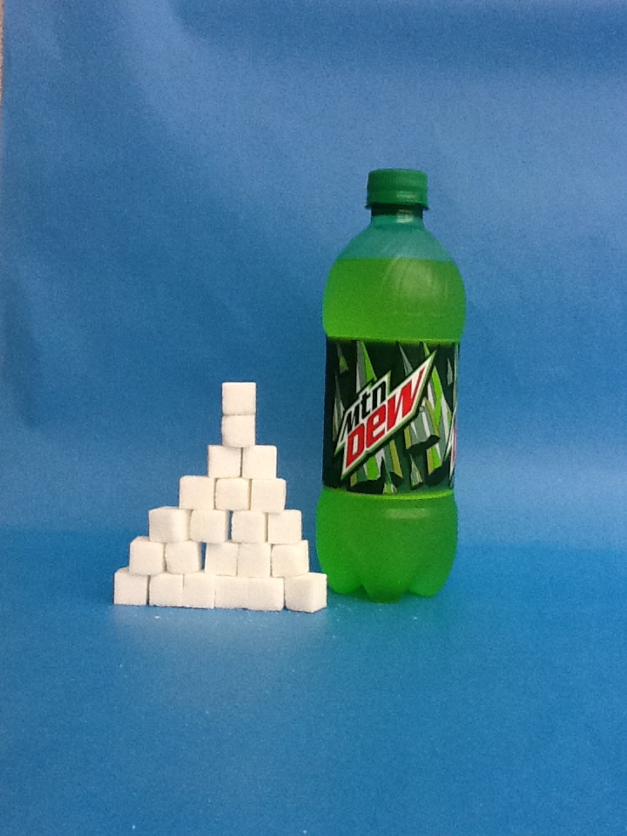
Mountain Dew
Serving Size: 453 g
Calories: 220
Carbohydrates: 62 g
Sugar:62 g

Slide 5
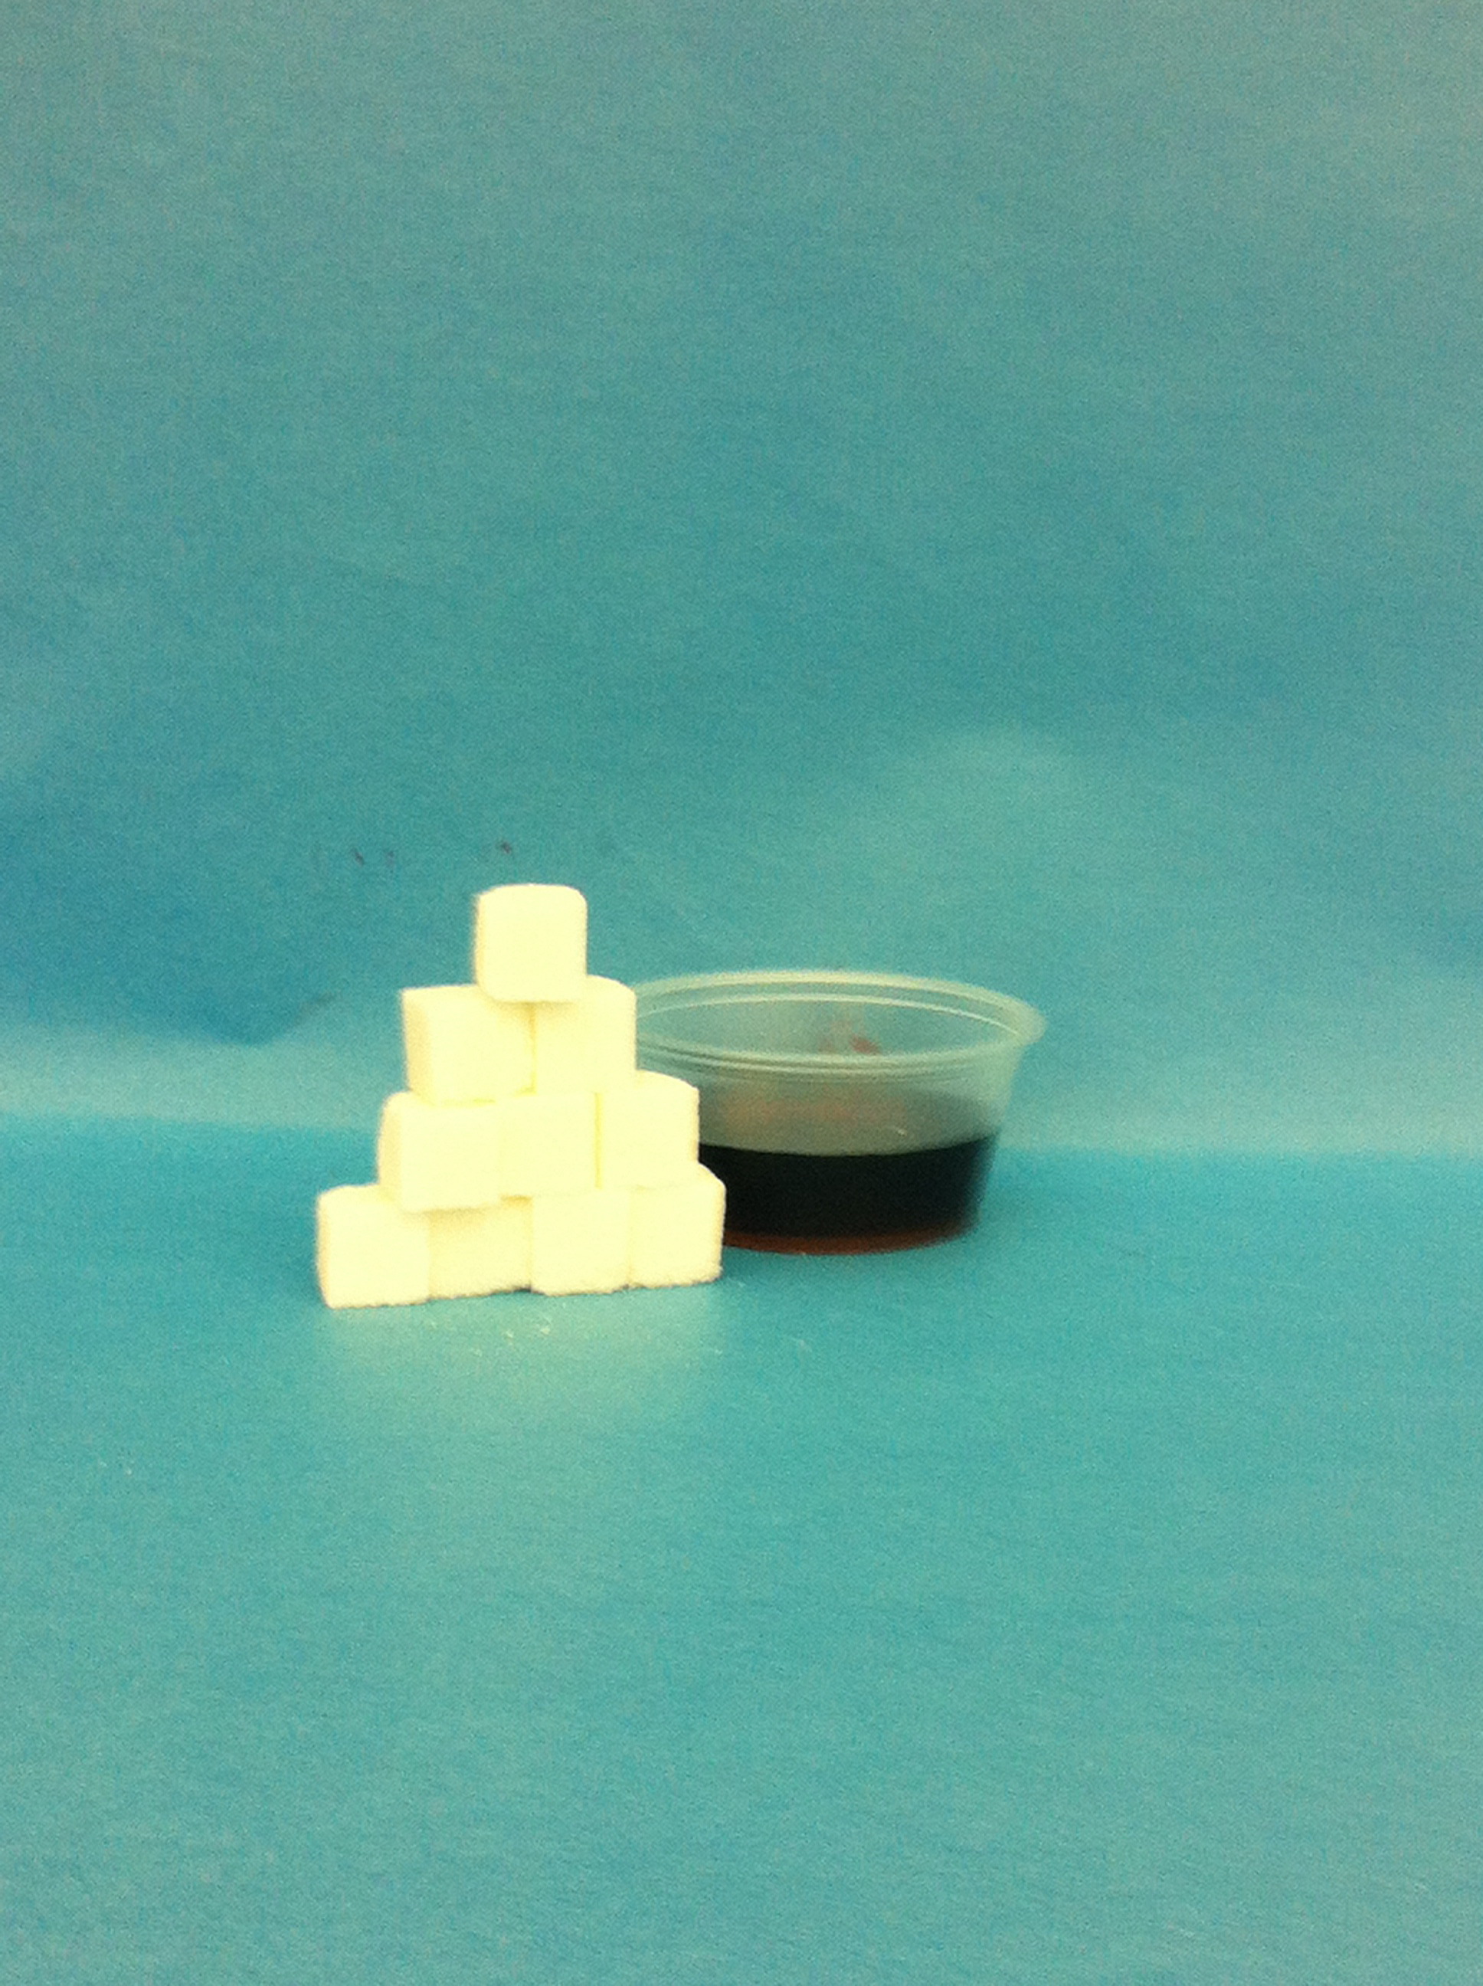
Maple Syrup
Serving Size: ¼ Cup
Calories: 200
Carbohydrates: 50 g
Sugar: 34 g

Slide 6
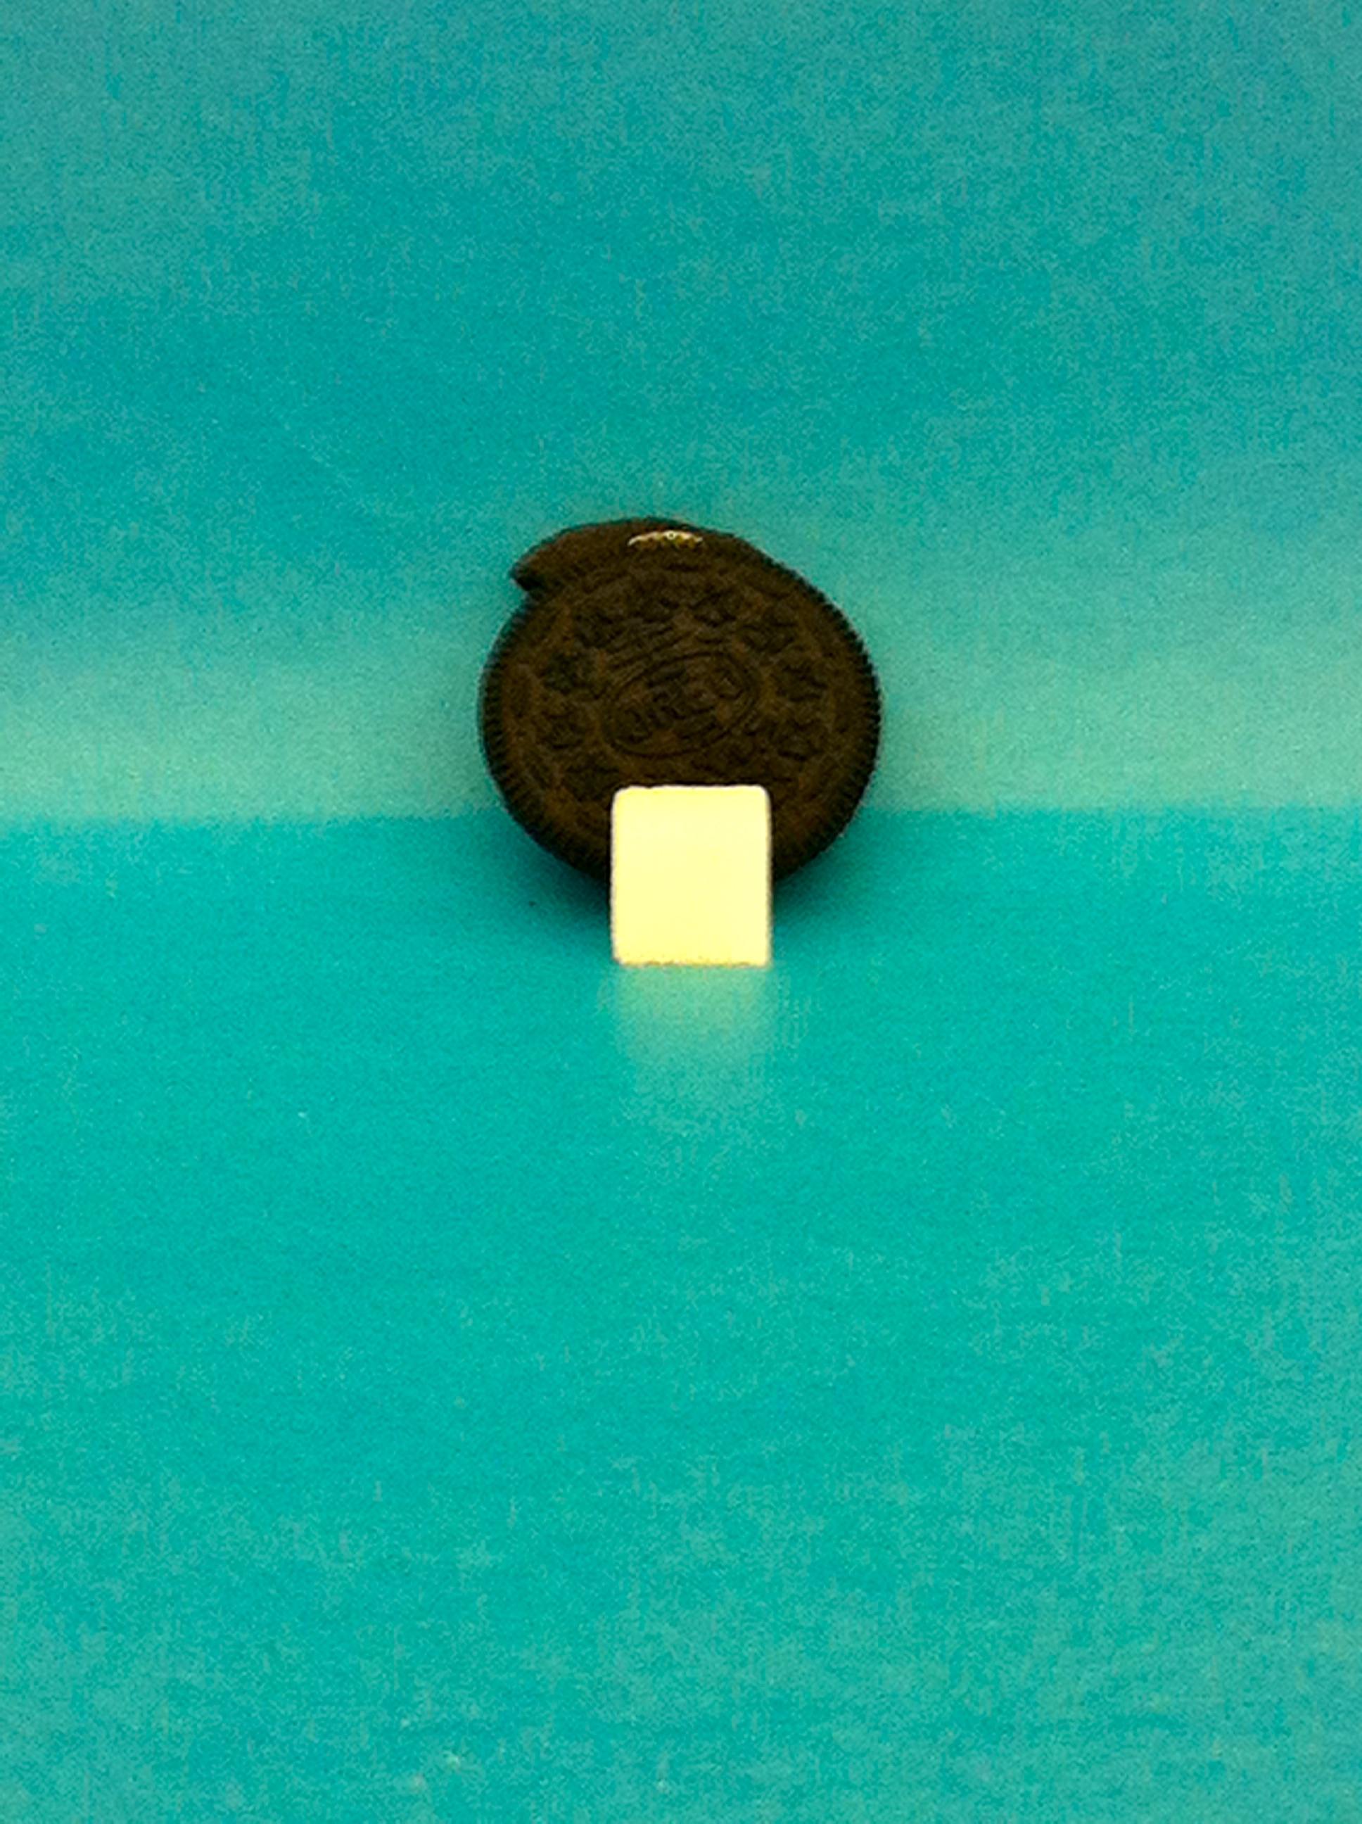
Oreo Cookie
Serving Size: 1 cookie
Calories: 100
Carbohydrates: 13 g
Sugar: 4 g

Slide 7
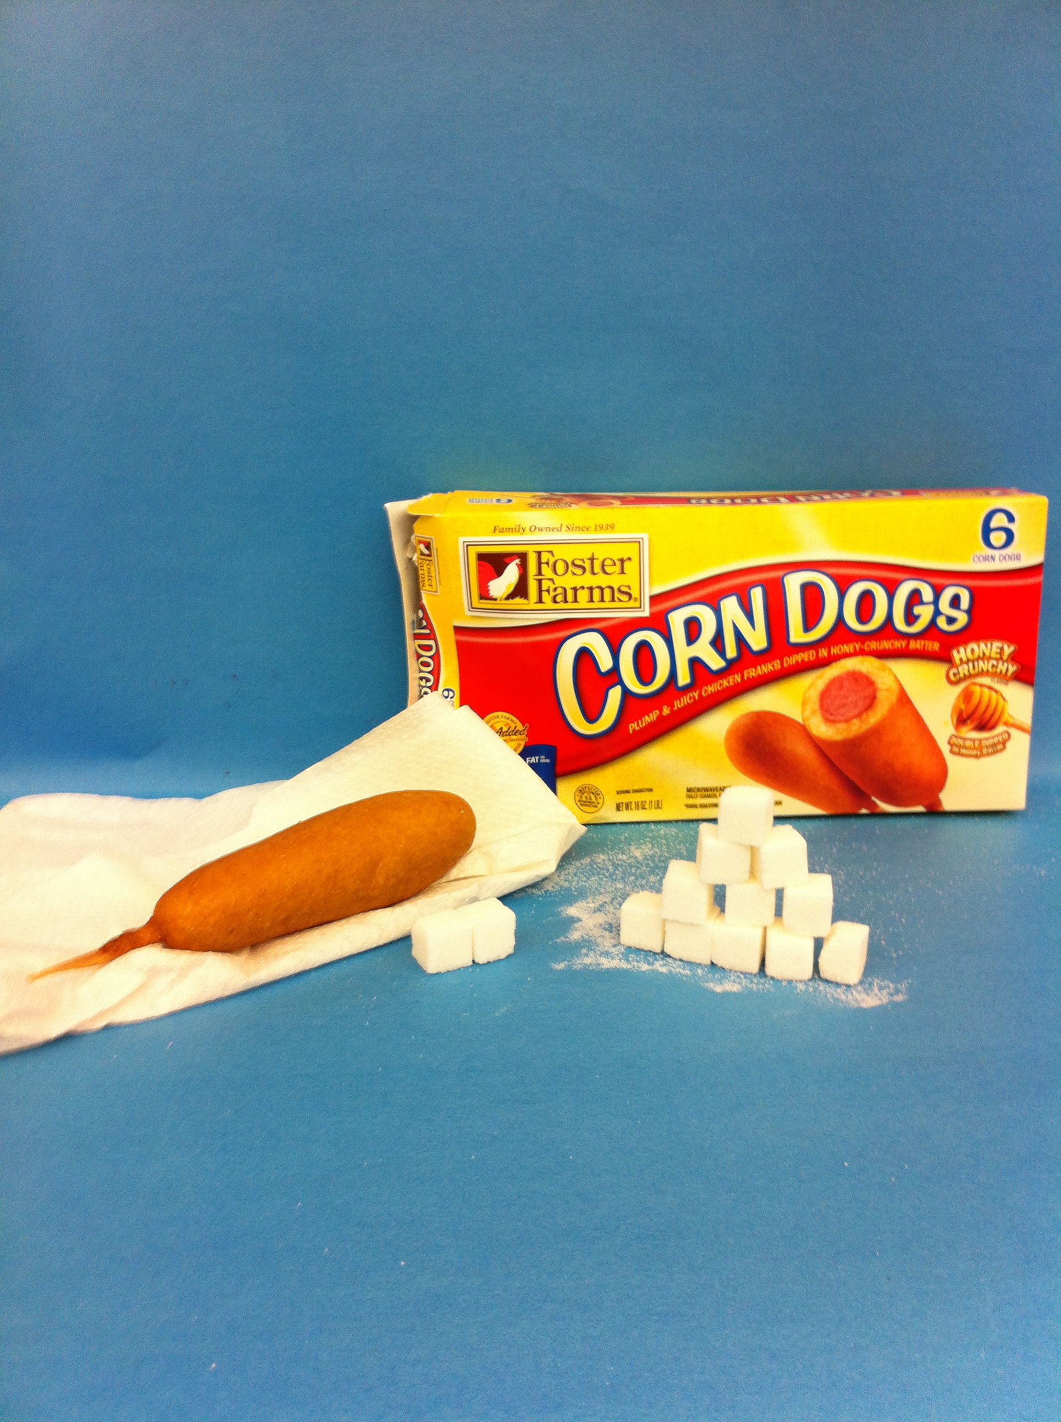
Corn Dog
Serving Size: 1 Large
Calories: 359
Carbohydrates: 26 g
Sugar: 4 g

Slide 8
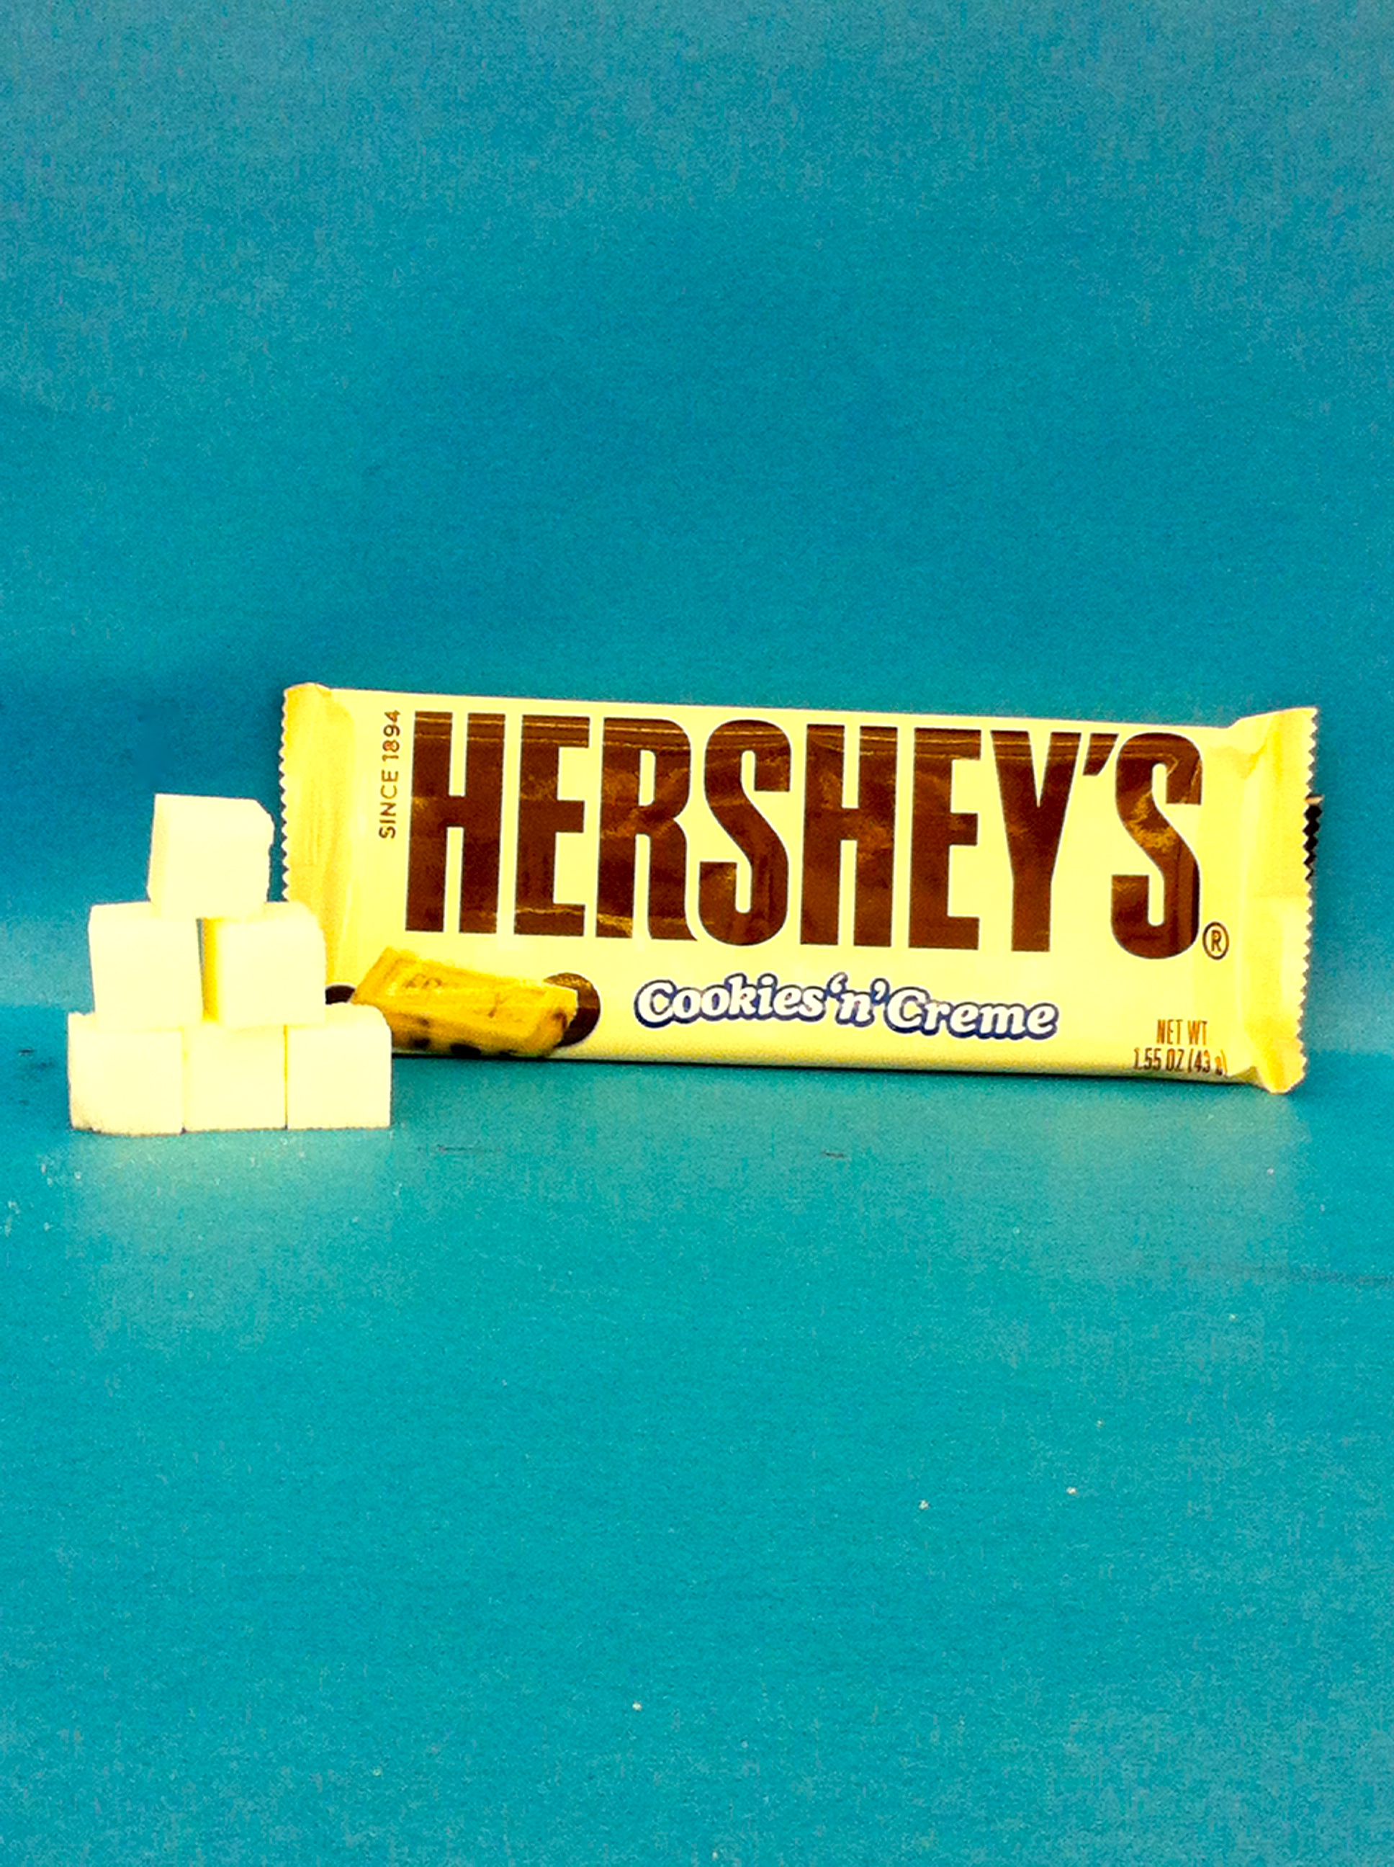
Hershey’s Cookies & Cream
Serving Size: 1 bar
Calories: 220
Carbohydrates: 26 g
Sugar: 19 g

Slide 9
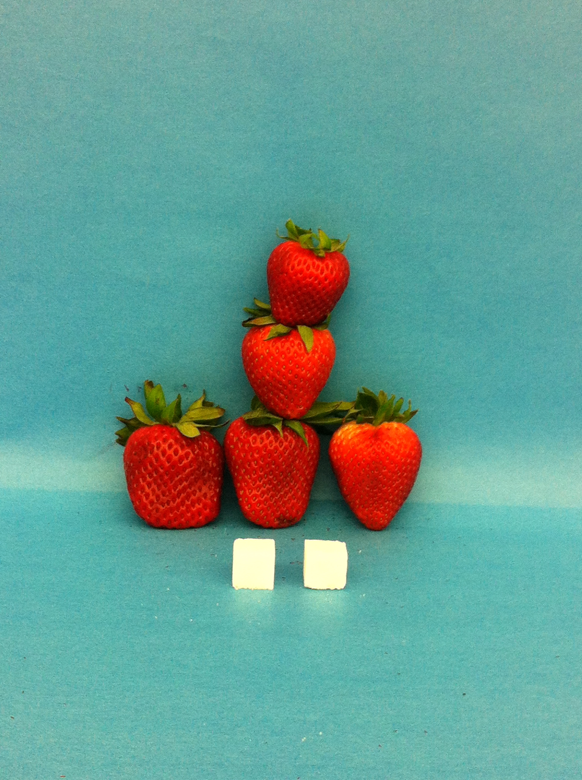
Fresh Strawberries
Serving Size: 1 cup
Calories: 49
Carbohydrates: 12 g
Sugar: 7 g

Slide 10
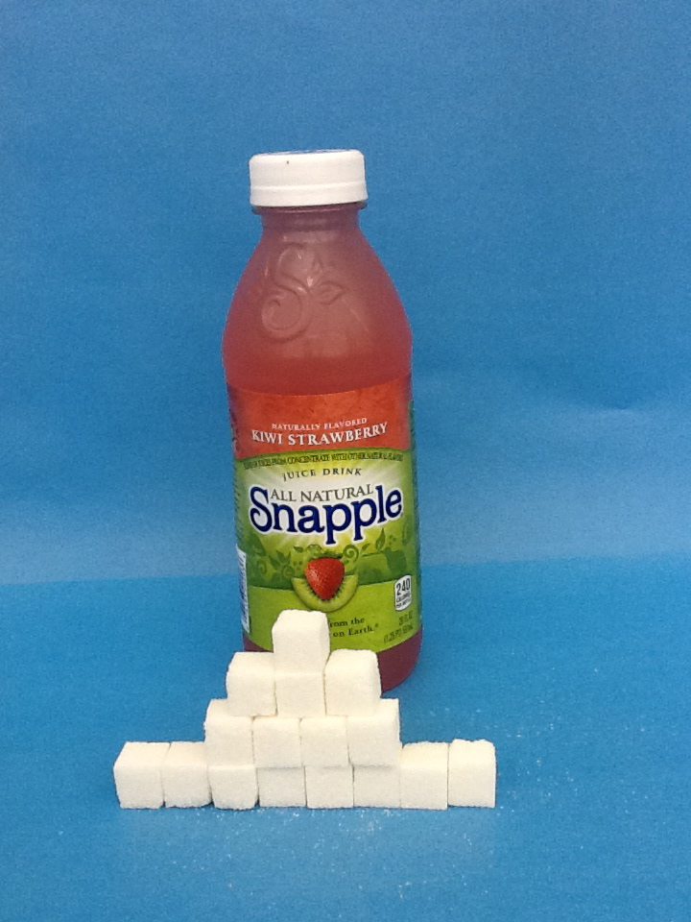
Snapple-Kiwi Strawberry
Serving Size: 20 0z.
Calories: 240
Carbohydrates: 58 g
Sugar: 56 g

Slide 11
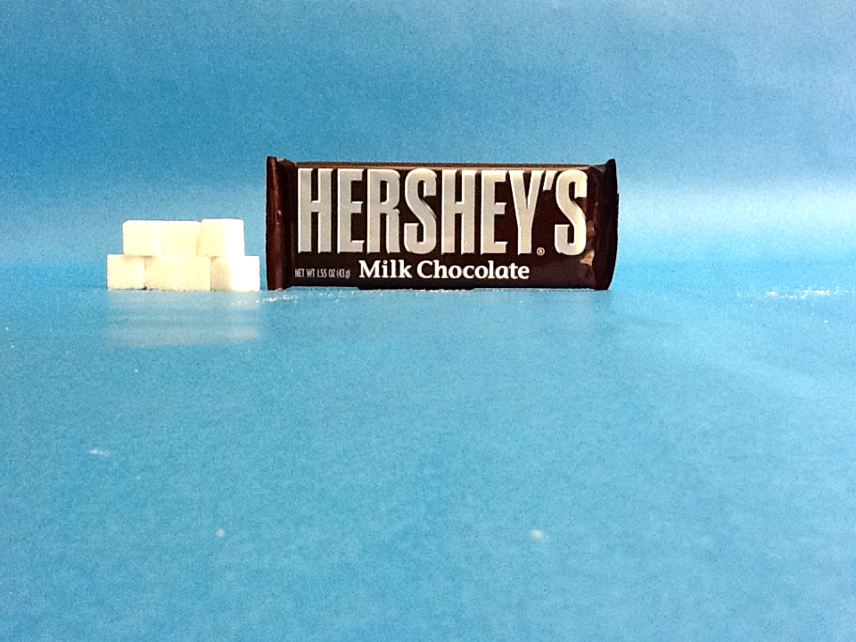
Hershey’s Chocolate Bar
Serving Size: 1 bar
Calories: 210
Carbohydrates: 26 g
Sugar: 24 g

Slide 12
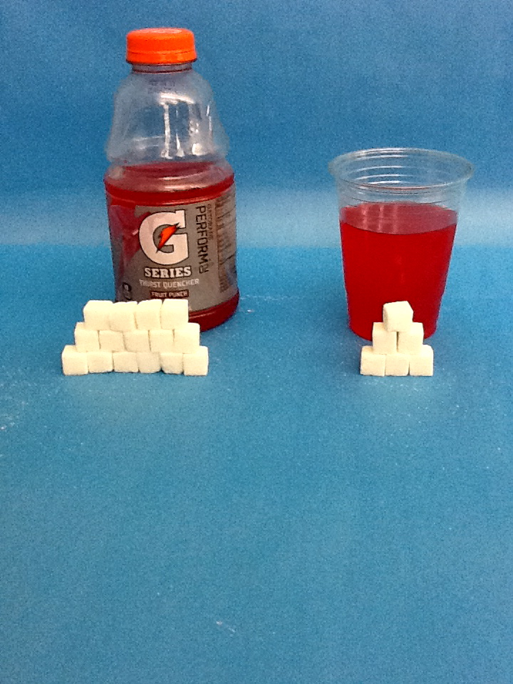
Gatorade Fruit Punch G2
Serving Size: 12 oz.
Calories: 30
Carbohydrates: 7 g
Sugar: 21 g

Slide 13
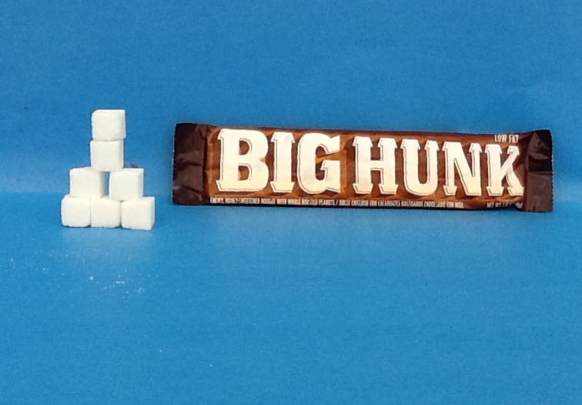
Big Hunk
Serving Size: 1 Bar
Calories: 230
Carbohydrates: 47 g
Sugar:23 g

Slide 14
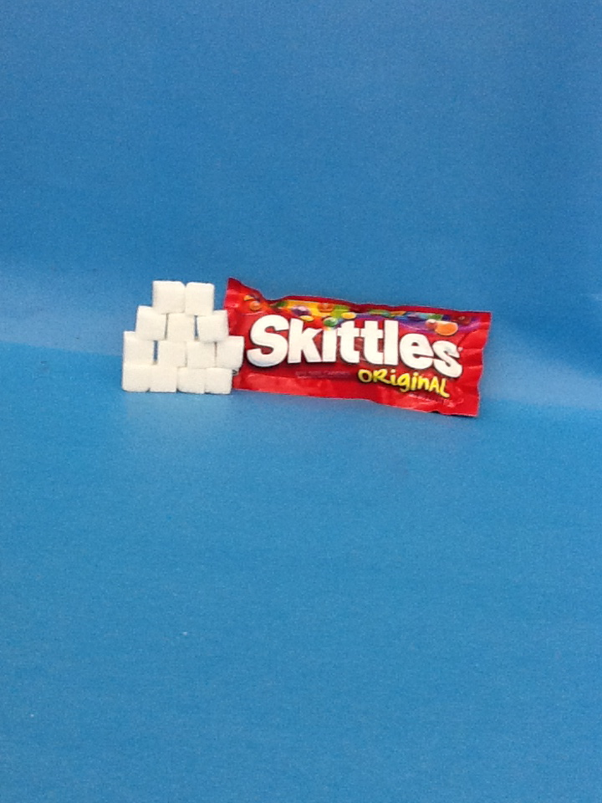
Skittles
Serving Size: 1 bag
Calories: 240
Carbohydrates: 54 g
Sugar: 44 g

